Slide 1



CHARTING
BARTERING
Hammad Javaid i21-1661
Aimal Khan i21-1701

Slide 2
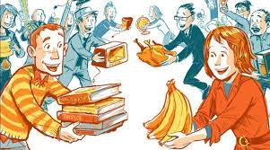
BARTERING AT YOUR FINGERTIPS
Exchange with goods of your liking.
Can also be used for income purposes as users can get real currency as well by selling products.
Can create job opportunities, eg; app handlers, delivery boys etc…..
Will open window to futuristic life.
Notes:
It will provide a digital platform for exchange of goods.
People can sell as well as buy products from the open market.

Slide 3

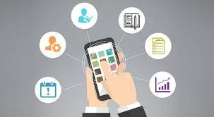
Defining Features
It will create a barter system where people can communicate with each other.
It will provide a detailed description of products off different categories that has value and is marketable. (crypto-currency & NFTS included).
Users will enlist their possessions in the market, buy from their and most importantly trade with something equal in worth to what they posses.
It will have no restrictions hence eliminating class difference.
Value of products will be calculated using advanced algorithms and through precise measurements and data.
Notes:
Will include possibly everything that is exchangeable and has value.
This app will be easy-to-use with no restrictions. TOTALLY FREE .PLUS NO ADS.
User history will be shared before any exchange to avoid scams.

Slide 4
How will it change
the current market
of apps?
It will revolutionize the current market of apps by only attracting interested users.
Although this is an age-old form of trading but introducing this to the digital world will create a new market for apps.
For example, during the crisis of COVID-19, if this app was available at that time, you would have been able to exchange your used sanitizer bottles with new face masks which you needed.
This app will efficiently help in resource management and will create a helpful environment.

Slide 5
Target Audience
Our app will mainly target students, middle-class and low income individuals.
It will provide products, services and marketing campaigns for a specific, well-defined group of people.
The ones who are in need of new products and have some useless items at their disposal which could be useful to others would be able to connect to each other via this app and get their desired product eg; food, book, furniture.

Slide 6
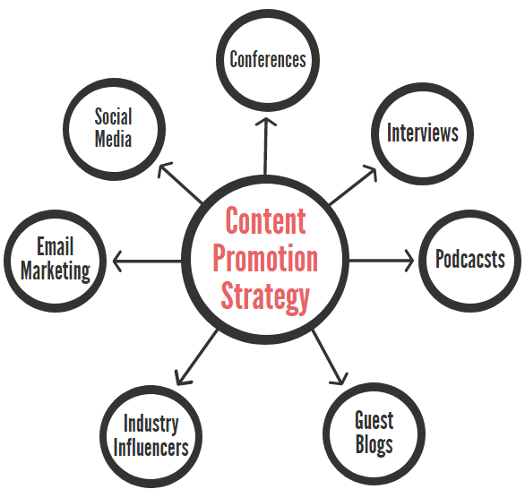
PROMOTION
STRATEGY
Through google ads
Youtube Influencing
Notes:
The system uses the following
to understand and store information:
Gestures
Voice recognition, facial and movement recognition
Sensors
Patterns/Daily routine
Activities

Slide 7
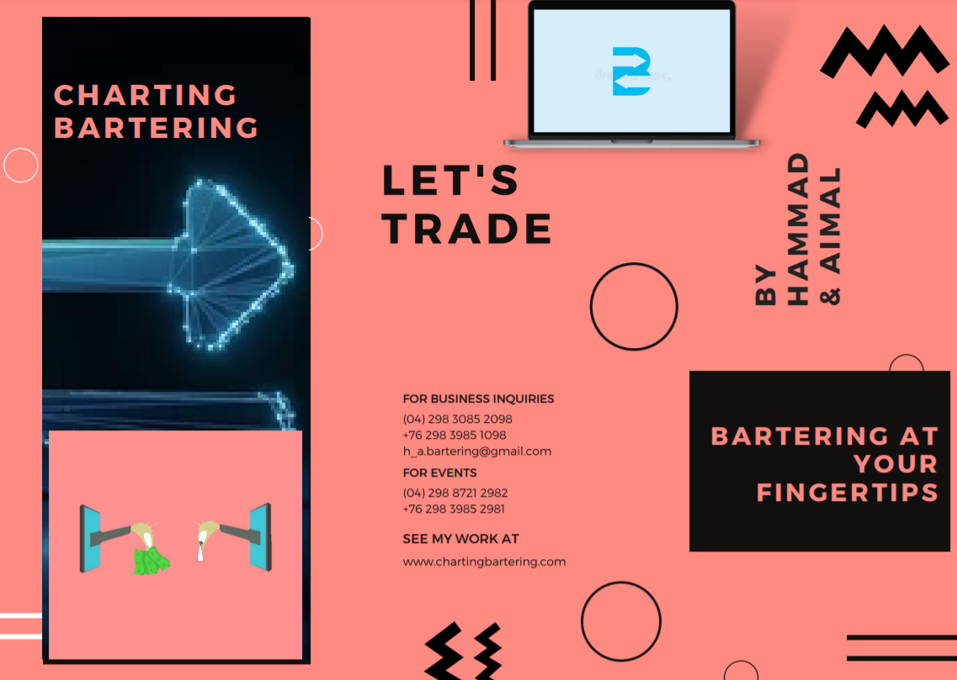

Slide 8
